Slide 1



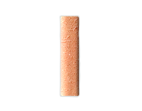
Final Team Project
Team 7
Bang Junwo
Wei Bumjun
Jeong Jeeeun
Han Gisu
Open Source Programming 03

Slide 2
Contents
Ⅰ. About Project
Ⅱ. Demonstration
Ⅲ. About Team Cooperation
Ⅳ. What Open Source Library We Used
Ⅴ. Open Source License for Our Project
Ⅵ. Milestone and Achievement

Slide 3
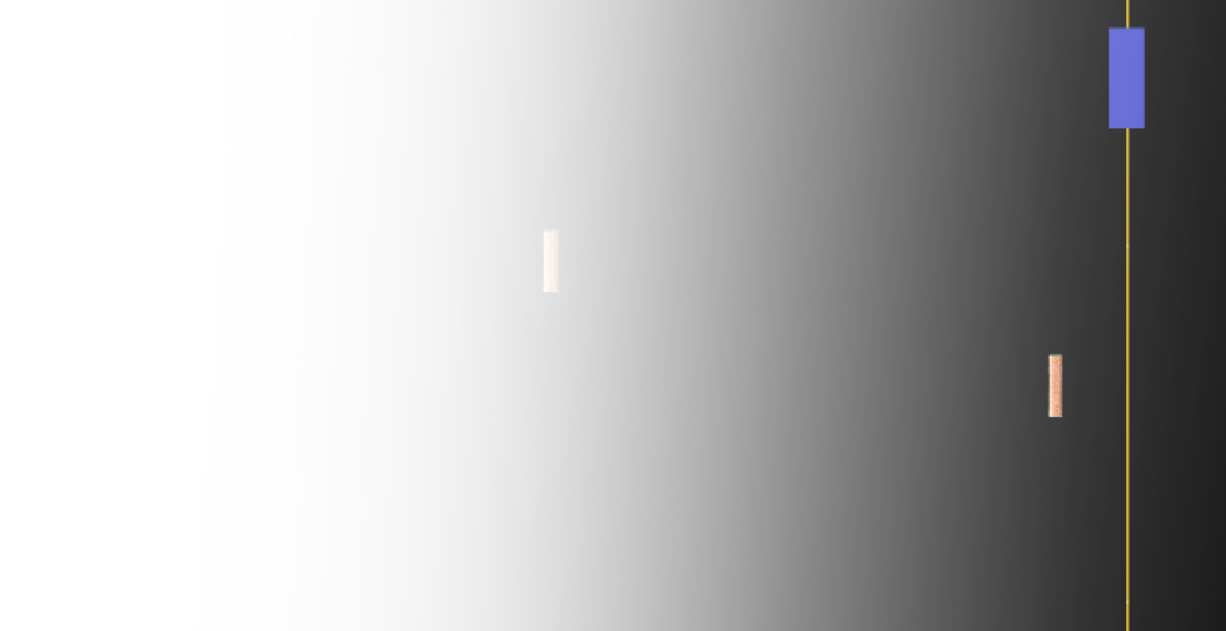
Ⅰ. About Project
Team7
Ⅰ
Ⅱ
Ⅲ
Ⅳ
Ⅴ
Ⅵ
Title: Motion Brick Break
Concept: Break as many bricks as possible before your stamina runs out
Play rules:
1. Brick shaped notes move left to right
2. Bar moves up and down by mouse wheel or hand moving
3. If the note comes close to the line, press any keyboard key to break
4. If you get it, you get +100 score and stamina
If you miss it, you get -50 score and lose stamina
5. Game overs when your stamina is 0

Slide 4
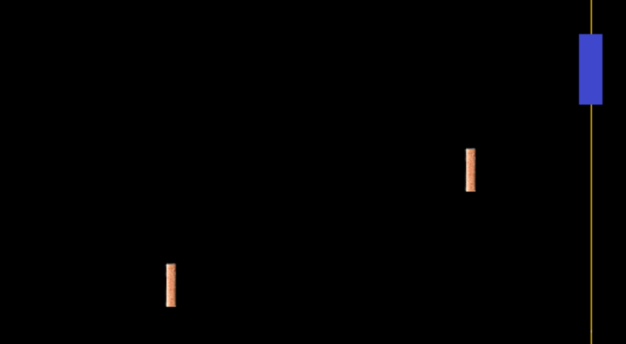
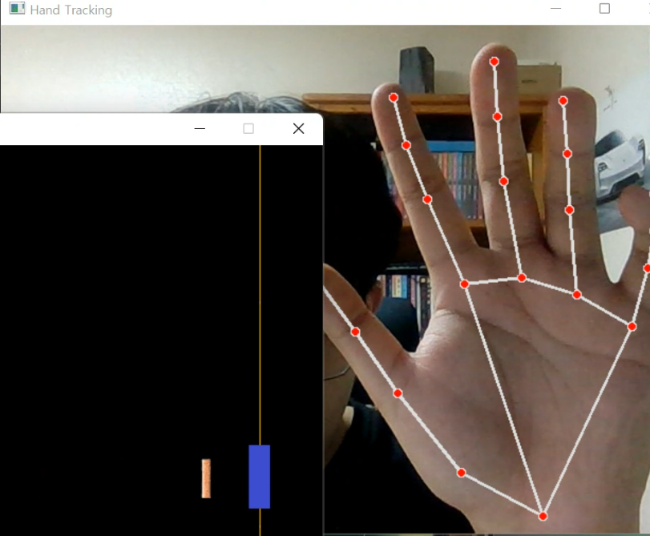
Team7
Ⅰ
Ⅱ
Ⅲ
Ⅳ
Ⅴ
Ⅵ
⇒ Play Screen
Notes move left to right.
⇒ Motion Recognition Screen
Recognize the hand with the camera and move the bar.

Slide 5
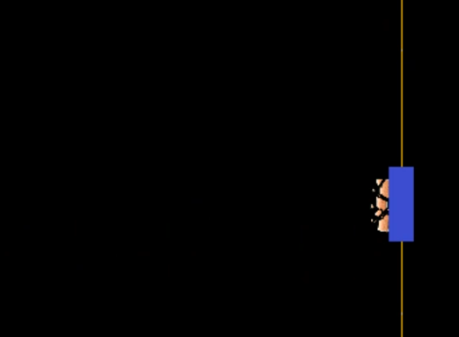
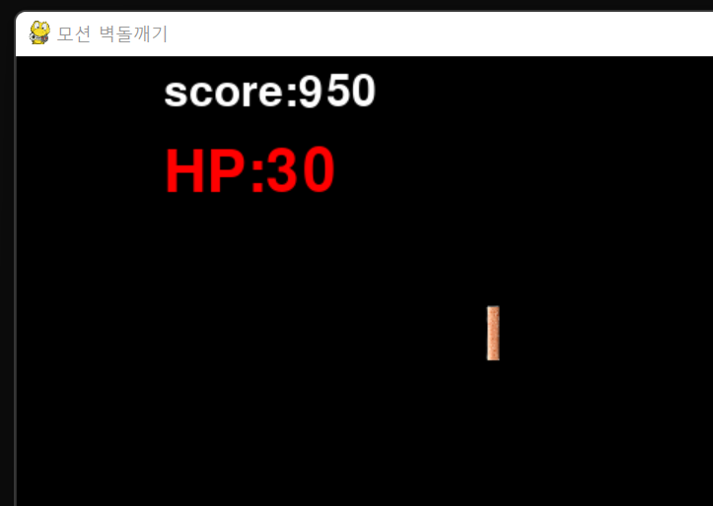



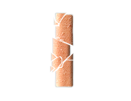
Team7
Ⅰ
Ⅱ
Ⅲ
Ⅳ
Ⅴ
Ⅵ
⇒ Note Effect
When you press the keyboard
key when the note comes down,
an animation that breaks appears.
⇒ Score and Stamina
Your score and stamina will increase or decrease
by your hit.

Slide 6
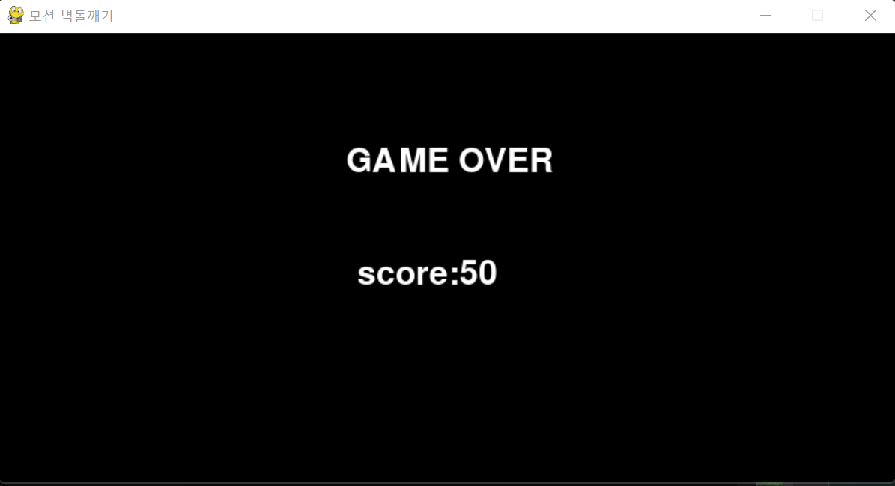
Team7
Ⅰ
Ⅱ
Ⅲ
Ⅳ
Ⅴ
Ⅵ
⇒ Game Over and Your Final Score
When the stamina reaches zero, the game ends and the final score is printed out.

Slide 7
Ⅱ. Demonstration

Slide 8
Ⅲ. About Team Cooperation
Team7
Ⅰ
Ⅱ
Ⅲ
Ⅳ
Ⅴ
Ⅵ
Bang Junwo
Mouse wheel bar
Score
Motion recognition
Background music
Jeong Jeeeun
Judgment line
Note effect
Game over/
Game clear window
Wei Bumjun
Note movement
HP
Start window
Code integration
Han Gisu
Note random position
Keyboard input
Motion recognition
Code integration

Slide 9
Ⅳ. What Open Source Library We Used
Team7
Ⅰ
Ⅱ
Ⅲ
Ⅳ
Ⅴ
Ⅵ
Open Source Library | Open Source License
Pygame | LGPL
OpenCV | Apache-2.0 License
Numpy | BSD-3
Mediapipe | Apache-2.0 License

Slide 10
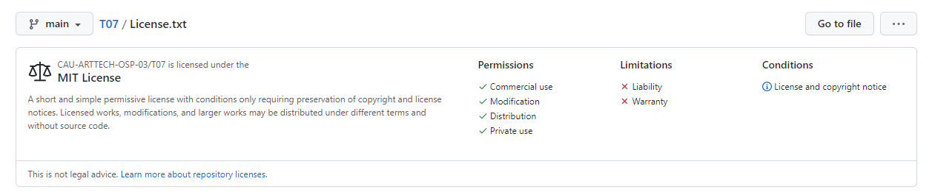
Ⅴ. Open Source License for Our Project
Team7
Ⅰ
Ⅱ
Ⅲ
Ⅳ
Ⅴ
Ⅵ
MIT License

Slide 11
Ⅵ. Milestone and Achievement
Team7
Ⅰ
Ⅱ
Ⅲ
Ⅳ
Ⅴ
Ⅵ
 |  | Week 1 |  |  |  |  |  |  | Week 2 |  |  |  |  |  |  | Week 3 |  |  |  |  |  |  | Week 4 |  |  |  |  |  |  | Week 5
 |  | 15 | 16 | 17 | 18 | 19 | 20 | 21 | 22 | 23 | 24 | 25 | 26 | 27 | 28 | 29 | 30 | 1 | 2 | 3 | 4 | 5 | 6 | 7 | 8 | 9 | 10 | 11 | 12 | 13 | 14 | 15 | 16 | 17 | 18 | 19 | 20
1st | 바
 | 이동
 | 선
 | 생성
2nd | 점수
 | 체력
 | 이펙트
 | 판정
3rd | 모션
 | 시작화면
 | 오버화면
4 | 오류
1단계: 모두 o
2단계: 모두 o (노트를 놓쳤을 때 이펙트 x)
3단계: 모션 인식 o (화면전환 x)
4단계: 코드 통합, 노트 디자인 및 애니메이팅

Slide 12
Thank you
for listening

